Slide 1
C/C++ Programming in a UNIX Environment CS 3377
Bhanu Kapoor, PhD Department of Computer Science
University of Texas, Dallas, TX
bhanu.kapoor@utdallas.edu
Notes Week 07
1

Slide 2
Reading for Week 06
Appendix A and Chapter 8 of A Practical Guide to Linux® Commands, Editors, and Shell Programming, Third Edition. Mark G. Sobell.
Appendix A: Regular Expressions
Chapter 8: The Bourne Again Shell
1

Slide 3
Agenda
Regular Expressions
Working with grep
The Shell
The Bourne-Again Shell (bash): Getting Started with Writing Scripts
1

Slide 4
Regular Expression
A regular expression is just a pattern of characters used to match the same characters in a search.
/word/
Regular Expression Metacharacters
Metacharacters are characters that represent something other than themselves.
Shell metacharacters and regular expression metacharacters.
rm *
◼ :1,$s/\<[Tt]om\>/David/g
1

Slide 5
Regular Expression Metacharacters
Metacharacter | Function | Example | What It Matches
^ | Beginning-of-line anchor | /^word/ | Matches all lines beginning with word
$ | End-of-line anchor | /word$/ | Matches all lines ending with word
. | Matches one character | /w..d/ | Matches lines containing an w, followed by two characters, followed by an d
* | Matches zero or more of the preceding characters | / *word/ | Matches lines with zero or more spaces, followed by the pattern word
1

Slide 6
Regular Expression Metacharacters
[ ] | Matches one in the set | /[Ww]ord/ | Matches lines containing word or Word
[x–y] | Matches one character within a range in the set | /[A–Z]ord/ | Matches letters from A through Zf ollowed by ord
[^ ] | Matches one character not in the set | /[^A–Z]/ | Matches any character not in the range between Aand Z
\ | Used to escape a metacharacter | /word\./ | Matches lines containing word, followed by a literal period; Normally the period matches one of any character
1

Slide 7
Regular Expression Metacharacters
\< | Beginning-of- word anchor | /\<word/ | Matches lines containing a word that begins with word)
\> | End-of-word anchor | /word\>/ | Matches lines containing a word that ends with word
1

Slide 8
Combining Metacharacters
/^[A–Z]..$/ Will find all lines beginning with a capital letter, followed by two of any character, followed by a newline.
/^[A–Z][a–z ]*3[0–5]/ Will find all lines beginning with an uppercase letter, followed by zero or more lowercase letters or spaces, followed by the number 3 and another number between 0 and 5.
/[a–z]*\ ./ Will find lines containing zero or more lowercase letters, followed by a literal period.
/^ *[A–Z][a–z][a–z]$/ Will find a line that begins with zero or more spaces (tabs do not count as spaces), followed by an uppercase letter, two lowercase letters, and a newline.
/^[A–Za–z]*[^,][A–Za–z]*$/ Will find a line that begins with zero or more uppercase and/or lowercase letters, followed by a noncomma, followed by zero or more upper- or lowercase letters and a newline.
1

Slide 9
The grep Family
grep: The grep command globally searches for regular expressions in files and prints all lines that contain the expression.
egrep: The egrep command is an extended grep, supporting more regular expression metacharacters. grep –E
fgrep: The fgrep command, called fixed grep, and sometimes fast grep, treats all characters as literals; that is, regular expression metacharacters aren't special—they match
themselves. grep -F
1

Slide 10
grep Command
$grep <word> <filename>
<filename> ..
$grep root /etc/passwd
$ps -ef | grep root
$grep ^root /etc/passwd
$grep main *.c
$grep ^main *.c
$grep }$ *.c
□ $grep ‘1\..' datafile

Slide 11
grep Command
□ $grep '^[mi]' *.c
□ $grep '[^0-9]' *.c
□ $grep '[A-Z][A-Z] [A-Z]' *.c
□ $grep 'ss* ' *.c
□ $grep '[a-z]\{9\}' *.c
□ $grep '\<int\>' *.c
□ $grep '\<[a-z].*n\>' *.c

Slide 12
grep Options
–b | Precedes each line by the block number on which it was found. This is sometimes useful in locating disk block numbers by context.
–c | Displays a count of matching lines rather than displaying the lines that match.
–h | Does not display filenames.
–i | Ignores the case of letters in comparisons (i.e., upper- and lowercase are considered identical).
–l | Lists only the names of files with matching lines (once), separated by newline characters.
–n | Precedes each line by its relative line number in the file.
–v | Inverts the search to display only lines that do not match.
–w | Searches for the expression as a word, as if surrounded by \< and \>. This applies to greponly. (Not all versions of grep support this feature; e.g., SCO UNIX does not.)

Slide 13
grep with options
□ $grep –n '\<[a-z].*n\>' *.c
□ $grep –i '\<[a-z].*n\>' *.c
□ $grep –v '\<[a-z].*n\>' *.c
□ $grep –l '\<[a-z].*n\>' *.c
□ $grep –c '\<[a-z].*n\>' *.c
□ $grep –w '\<[a-z].*n\>' *.c
$grep -i for *.c
$ls -l | grep '^d‘

Slide 14
grep Recap
grep '\<Tom\>' file
grep 'Tom Savage' file grep '^Tommy' file grep '\.bak$' file
grep '[Pp]yramid' *
grep '[A–Z]' file
grep '[0–9]' file
Prints lines containing the word Tom.
Prints lines containing Tom Savage.
Prints lines if Tommy is at the beginning of the line.
Prints lines ending in .bak. Single quotes protect the dollar
sign ($) from interpretation.
Prints lines from all files containing pyramid or Pyramid in the current working directory.
Prints lines containing at least
one capital letter.
Prints lines containing at least one number.

Slide 15
grep Recap
grep '[A–Z]...[0–9]' file
Prints lines containing five- character patterns starting with a capital letter and ending with a number.
Prints lines with the word Test and/or test.
Finds lines containing Mark Todd, but does not print the lines. Can be used when checking grep's exit status.
Prints all lines not
containing Mary.
Prints all lines containing sam,
regardless of case
(e.g.,SAM, sam, SaM, sAm).
grep –w '[tT]est' files
grep –s 'Mark Todd' file
grep –v 'Mary' file
grep –i 'sam' file

Slide 16
grep Recap
grep –l 'Dear Boss' *
grep –n 'Tom' file grep "$name" file
Lists all filenames containing Dear Boss.
Precedes matching lines with line
numbers.
Expands the value of
variable name and prints lines containing that value. Must use double quotes.
Prints lines containing literal $5. Must use single quotes.
Pipes output of ps –ef to grep, searching for user1 at the beginning of a line, even if it is preceded by zero or more spaces.
grep '$5' file
ps –ef| grep '^ *user1'

Slide 17
Extended grep
Metacharacter | Function | Example | What It Matches
+ | Matches one or more of the preceding characters | [a–z]+ord | Matches one or more lowercase letters, followed by ord. Would find word, chord, accord, etc.
? | Matches zero or one of the preceding characters | wo?rd | Matches for an w followed by either one or not any o's at all. Would find word wrd
a|b|c | Matches either a or b orc | word|text | Matches for either expression, word or text.
( ) | Groups characters | word(ing|s) | Matches for wording or words.

Slide 18
Extended grep
(..) (...) \1 \2^{[a]}
Tags matched characters
\(word\)ing
Tags marked portion in a register to be remembered later as number 1. To reference later,
use \1 to repeat the pattern. May use up to nine tags, starting with the first tag at the leftmost part of the pattern. For example, the
pattern word is saved in register 1 to be referenced later
as \1.
Matches if line has 5 occurrences of o, at least 5 occurrences of o, or between 5 and 10 occurrences of o.
Repetition of characterx: m times, at least mtimes, or
between m andn time o\{5\} o\{5,\} s o\{5,10\}
x{m} x{m,}
x{m,n^{[b]}

Slide 19
fgrep
$ fgrep '[A-Z]****[0-9]..$5.00' file or
$ grep -F '[A-Z]****[0-9]..$5.00' file
No special characters here when using –F or fgrep.
grep 'pattern' filename(s) | Basic RE metacharacters (the default)
grep –G 'pattern' filename(s) | Same as above; the default
grep –E 'pattern' filename(s) | Extended RE metacharacters
grep –F 'pattern' filename | No RE metacharacters
grep –P 'pattern' filename | Interpret the pattern as a Perl RE

Slide 20
Questions
Print all lines containing the string John.
Print all lines where a word starts with J.
Print all lines ending with word stopped.
Print all lines that don't contain was.
Print lines where a word begins with K or k.
Create a file having at least one match for all the commands in slides 15-17.

Slide 21
Agenda
Regular Expressions
Working with grep
The Shell
The Bourne-Again Shell (bash): Getting Started with Writing Scripts

Slide 22
The Shell
Command Line Processing
Standard IO
Redirection
Appending
Pipe and Filter
Running Jobs in Background
Shell Special Characters

Slide 23
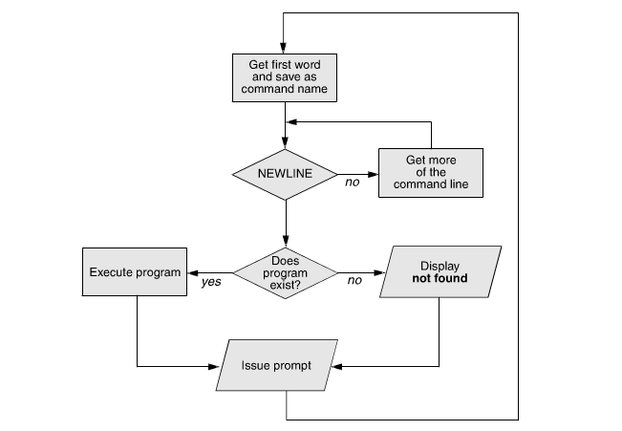
Command Line Processing

Slide 24
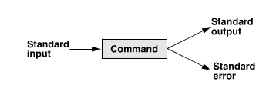
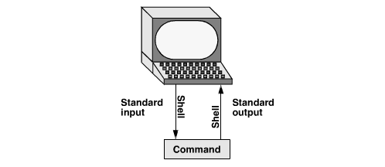
Standard Input and Output

Slide 25
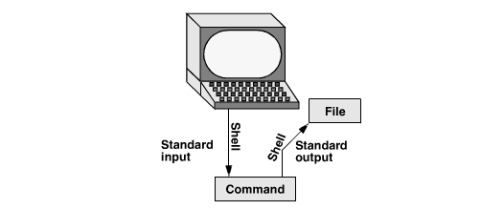
Redirection
command [arguments] > filename
$ cat > sample.txt

Slide 26
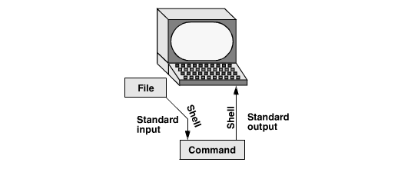
Redirection
command [arguments] < filename
$ cat < sample.txt

Slide 27
Avoid Overwriting Files
Noclobber option
$ touch tmp
$ set -o noclobber
$ echo "hi there" > tmp
bash: tmp: cannot overwrite existing file
$ set +o noclobber
$ echo "hi there" > tmp

Slide 28
Appending Standard Output
Append with >>
$ cat orange
this is orange
$ cat pear >> orange
$ cat orange
this is orange
this is pear
/dev/null: Making Data Disappear
$ echo "hi there" > /dev/null

Slide 29
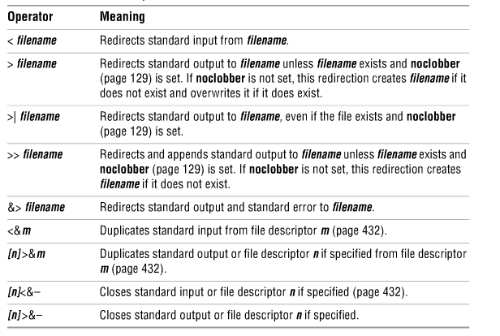
Redirection Operators

Slide 30
Pipe and Filter
The shell uses a pipe to connect standard output of one command to standard input of another command.
command_a [arguments] | command_b [arguments]
$ cat abstract | tr abc ABC
□ $ tr abc ABC < abstract
$ who | grep 'sam‘
$ ls | less
A filter is a command that processes an input stream of data to produce an output stream of data.
$ who | sort
◼ $ who | tee who.out | grep sam
30

Slide 31
Running a job in the background
$ who | sort &
□ [1] 22092
□ $
When job completes
[1]+ Done who | sort &
Restart after suspending
$bg
Bring to foreground
$fg 1

Slide 32
Shell Special Characters
The special character ?
$ ls memo?
$ ls
mem memo12 | memo9 | memomax newmemo5
memo memo5 | memoa | memos
□ $ ls memo? memo5 memo9 | memoa | memos
The special character *
$ls memo*
memo12 memo9 memomax memo5 memoa memos
newmemo5 memo

Slide 33
Shell Special Characters
The special character []
$ls memo[01a] memoa
$ ls part0 part1 part2 part3 part5
□ $ ls part[01235]
$ ls
aa ab ac ad ba bb bc bd cc dd
$ ls *[^ab] //any file that doesn’t end with
ac ad bc bd cc dd
$ ls [^b-d]* //any file that doesn’t start with
aa ab ac ad
33

Slide 34
Agenda
The Shell
The Bourne-Again Shell (bash): Getting Started with Writing Scripts

Slide 35
bash
Startup Files
Redirecting Standard Error
Writing a Simple Shell Script
Job Control
Manipulating the Directory
Stack
Parameters and Variables
Processes
History
Re-executing and Editing
Commands
Functions
Controlling bash: Features and Options
Processing the Command Line

Slide 36
Start up Files
/etc/profile
~/.bash_profile
~/.bash_login
~/.profile
~/.bash_logout

Slide 37
Interactive Nonlogin Shells
/etc/bashrc
~/.bashrc may call /etc/bashrc
BASH_ENV variable
Setting up start up files
◼ if [ -f ~/.bashrc ]; then . ~/.bashrc; fi
$ more ~/.bashrc

Slide 38
Environment Variables
$ echo $SHELL
/bin/bash
$ echo $PATH
/usr/X11R6/bin:/usr/local/bin:/bin:/usr/bin
PATH=$PATH:$HOME/bin
export PATH
Environmental variables are defined in /etc/profile,
/etc/profile.d/ and ~/.bash_profile. These files are the initialization files and they are read when bash shell is invoked.
When a login shell exits, bash reads ~/.bash_logout
The startup is more complex; for example, if bash is used interactively, then /etc/bashrc or ~/.bashrc are read. See the man page for more details.

Slide 39
Sample .bashrc file
$ cat ~/.bashrc
if [ -f /etc/bashrc ]; then source /etc/bashrc
fi
set -o noclobber unset MAILCHECK export LANG=C
# read global startup file if it exists
# prevent overwriting files
# turn off "you have new mail" notice # set LANG variable
export VIMINIT='set ai aw' # set vim options
alias df='df -h' alias rm='rm -i'
alias lt='ls -ltrh | tail' alias h='history | tail' alias ch='chmod 755 '
function switch()
# set up aliases
# always do interactive rm's
# a function to exchange the names
{ # of two files local tmp=$$switch
mv "$1" $tmp mv "$2" "$1" mv $tmp "$2"
}
. Or source runs the .bashrc $ . ~/.bashrc

Slide 40
Writing a Simple Shell Script
$ cat whoson date
echo "Users Currently Logged In" who
$ ./whoson
bash: ./whoson: Permission denied
$ ls -l whoson
$ chmod u+x whoson
$ ls -l whoson
$ ./whoson
□ $bash whoson
40

Slide 41
Specifying a shell
□ $ cat bash_script
#!/bin/bash
echo "This is a Bourne Again Shell script.“
date
echo "Users Currently Logged In" Who
□ $ cat tcsh_script #!/bin/tcsh
echo "This is a tcsh script." set person = zach
echo "person is $person"

Slide 42
Read Command
#!/bin/bash
echo -n “Enter name of file to delete: ”
read file
echo “Type 'y' to remove it, 'n' to change your mind ... ”
rm -i $file
echo "That was YOUR decision!”
The read command allows you to prompt for input and store it in a variable. Line 2 prompts for a string that is read in line 3. Line 4 uses the interactive remove (rm -i) to ask the user for confirmation.

Slide 43
Arithmetic Evaluation
□ The let statement can be used to carry out mathematical functions
$ let X=10+2*5
$ echo $X 20
$ let Y=X+2*5
$ echo $Y 30

Slide 44
Arithmetic Evaluation
□ An arithmetic expression can be evaluated by
$[expression] or $((expression))
$ echo “$((10+20))”
30
$ Z=$[10+20]
$ echo “$[5*$Z]”
□ ?
□ available operators: +, -, /, *, %

